Slide 1
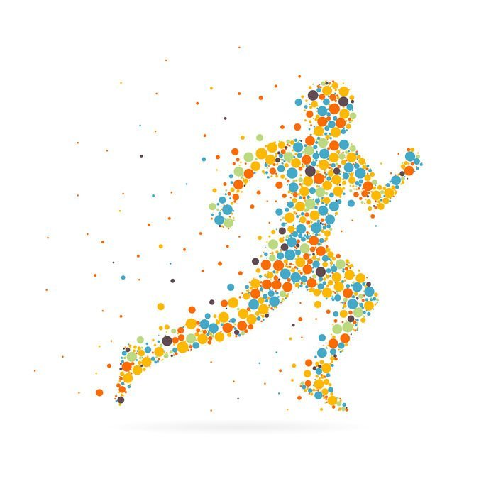


Human Activity Recognition using Smartphones
INSAID
Project Term : IV ML - II
By: Satpute Vishweshwar

Slide 2
Data Set Information
The experiments have been carried out with a group of 30 volunteers within an age bracket of 19-48 years.
Each person performed six activities (WALKING, WALKING_UPSTAIRS, WALKING_DOWNSTAIRS, SITTING, STANDING, LAYING) wearing a smartphone (Samsung Galaxy S II) on the waist.
Using its embedded accelerometer and gyroscope, we captured 3-axial linear acceleration and 3-axial angular velocity at a constant rate of 50Hz.
The experiments have been video-recorded to label the data manually.

Slide 3
Problem Statement
To Find the ML-Algorithm which Predict the Activity Outcome.
The Data set contains : 3609 Rows & 563 Columns.
No Duplicates found.
No Null / Missing Values are present in the Data Set.

Slide 4
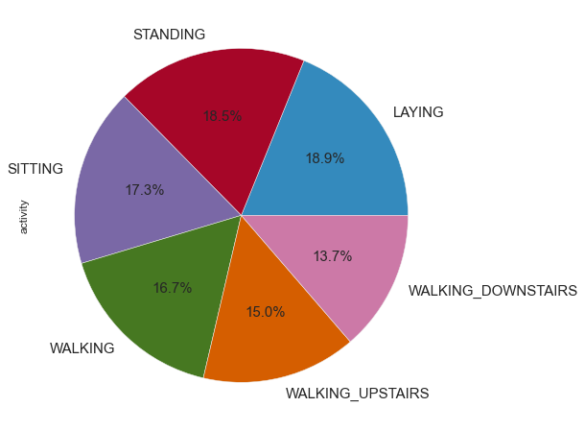
Various Activity
These are the different activities performed for experiment
1. WALKING
2. WALKING_UPSTAIRS
3. WALKING_DOWNSTAIRS
4. SITTING
5. STANDING
6. LAYING

Slide 5
Here the data with 3609 rows × 563 columns with 6 different activities, we will be considering two Activity for better understanding and processing considering Standing and Sitting activities on which we will be implementing the ML algorithm.
The Activities which we have selected for Processing are:

Slide 6
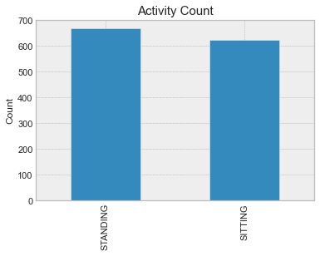
Selected Activities
STANDING 668
SITTING 623

Slide 7
Preparing x and y
Preparing Explanatory Variables as x
Preparing Target Variables as y
Shape of X Training Data is (1032, 562)
Shape of X Test Data is (259, 562)
Shape of Y Training Data is (1032)
Shape of Y Test Data is (259

Slide 8
Logistic Regression
Confusion Matrix | Predicted Standing | Predicted Sitting
Actual Standing | 110 | 13
Actual Sitting | 8 | 128
Accuracy
91.8918918918919
Processing Time
0.578125
 | Precision | Recall | F1-Score | Support
0 | 0.93 | 0.89 | 0.91 | 123
1 | 0.91 | 0.94 | 0.92 | 136
Accuracy |  |  | 0.92 | 259
Macro Avg | 0.92 | 0.92 | 0.92 | 259
Weighted Avg | 0.92 | 0.92 | 0.92 | 259

Slide 9
Decision Tree
Confusion Matrix | Predicted Standing | Predicted Sitting
Actual Standing | 108 | 15
Actual Sitting | 18 | 118
Accuracy
87.25868725868726
Processing Time
0.67185
 | Precision | Recall | F1-Score | Support
0 | 0.86 | 0.88 | 0.87 | 123
1 | 0.89 | 0.87 | 0.88 | 136
Accuracy |  |  | 0.87 | 259
Macro Avg | 0.87 | 0.87 | 0.87 | 259
Weighted Avg | 0.87 | 0.87 | 0.87 | 259

Slide 10
Random Forest
Confusion Matrix | Predicted Standing | Predicted Sitting
Actual Standing | 120 | 3
Actual Sitting | 6 | 130
Accuracy
96.52509652509652
Processing Time
1.53125
 | Precision | Recall | F1-Score | Support
0 | 0.95 | 0.98 | 0.96 | 123
1 | 0.98 | 0.96 | 0.97 | 136
Accuracy |  |  | 0.97 | 259
Macro Avg | 0.96 | 0.97 | 0.97 | 259
Weighted Avg | 0.97 | 0.97 | 0.97 | 259

Slide 11
KNN
Confusion Matrix | Predicted Standing | Predicted Sitting
Actual Standing | 118 | 5
Actual Sitting | 14 | 122
Accuracy
92.66409266409266
Processing Time
0.5625
 | Precision | Recall | F1-Score | Support
0 | 0.89 | 0.96 | 0.93 | 123
1 | 0.96 | 0.90 | 0.93 | 136
Accuracy |  |  | 0.93 | 259
Macro Avg | 0.93 | 0.93 | 0.93 | 259
Weighted Avg | 0.93 | 0.93 | 0.93 | 259

Slide 12
SVM
Confusion Matrix | Predicted Standing | Predicted Sitting
Actual Standing | 111 | 12
Actual Sitting | 11 | 125
Accuracy
91.11969111969111
Processing Time
221.515625
 | Precision | Recall | F1-Score | Support
0 | 0.91 | 0.90 | 0.91 | 123
1 | 0.91 | 0.92 | 0.92 | 136
Accuracy |  |  | 0.91 | 259
Macro Avg | 0.91 | 0.91 | 0.91 | 259
Weighted Avg | 0.91 | 0.91 | 0.91 | 259

Slide 13
Naive Bayes
Confusion Matrix | Predicted Standing | Predicted Sitting
Actual Standing | 63 | 60
Actual Sitting | 1 | 135
Accuracy
76.44787644787645
Processing Time
0.09375
 | Precision | Recall | F1-Score | Support
0 | 0.98 | 0.51 | 0.67 | 123
1 | 0.69 | 0.99 | 0.82 | 136
Accuracy |  |  | 0.76 | 259
Macro Avg | 0.84 | 0.75 | 0.74 | 259
Weighted Avg | 0.83 | 0.76 | 0.75 | 259

Slide 14
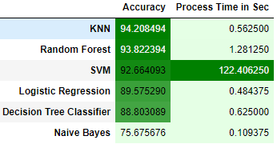
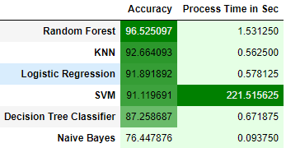
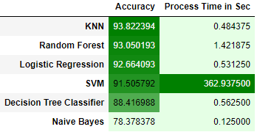
Consolidate Report

Slide 15
Final Report
 | Accuracy | Process time in sec
KNN | 93.822394 | 0.484375
Random Forest | 93.050193 | 1.421875
Logistic Regression | 92.664093 | 0.531250
SVM | 91.505792 | 362.937500
Decision Tree Classifier | 88.416988 | 0.562500
Naive Bayes | 78.378378 | 0.125000
From the above report we can see ‘KNN’
Out perform the rest of the Algorithm,
though ‘Random Forest’ takes up the lead on multiple trials

Slide 16
Thank You…

